Slide 1
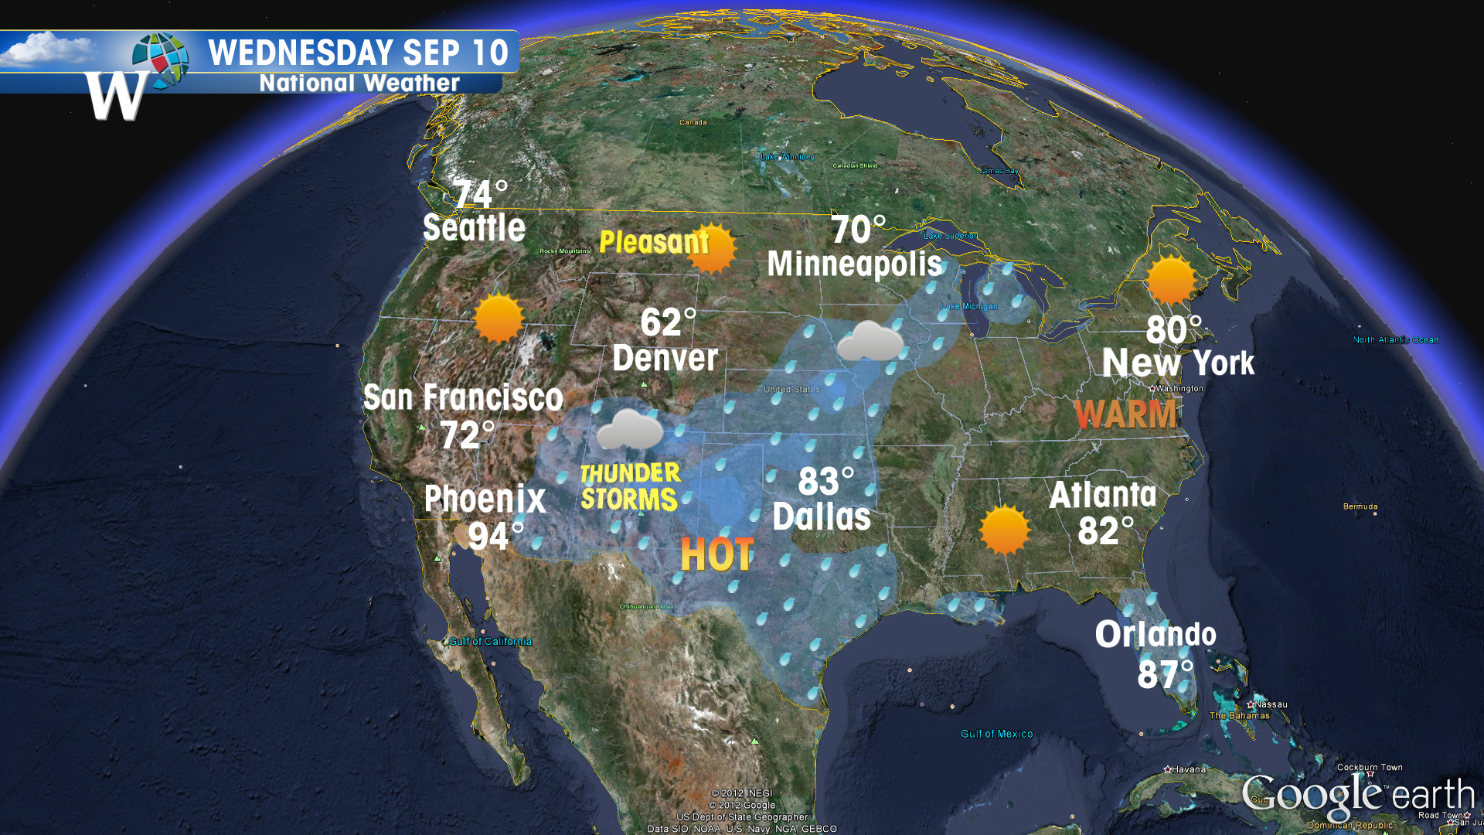
Its Raining Bots!
Esther @esthermonisha
Emerging Technology Products Group Future Focus Infotech

Slide 2
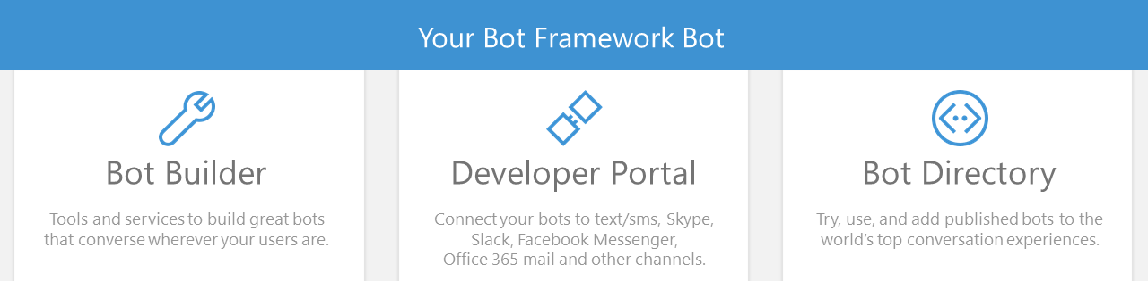
Microsoft Bot Framework

Slide 3
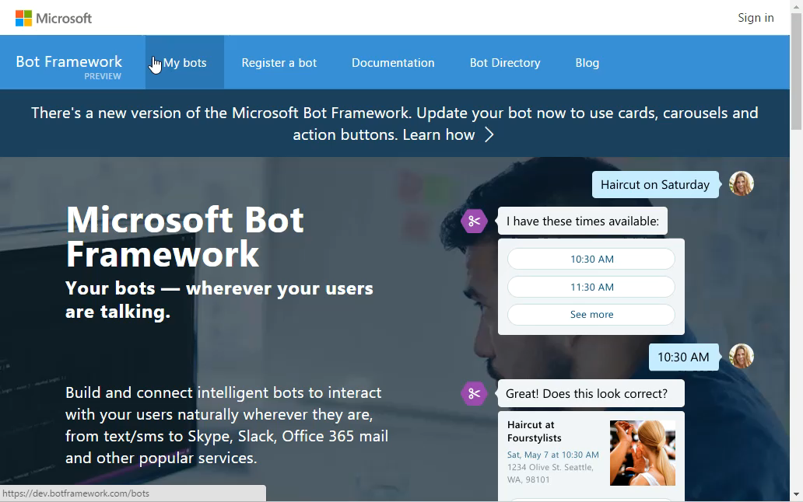
Click to play

Slide 4
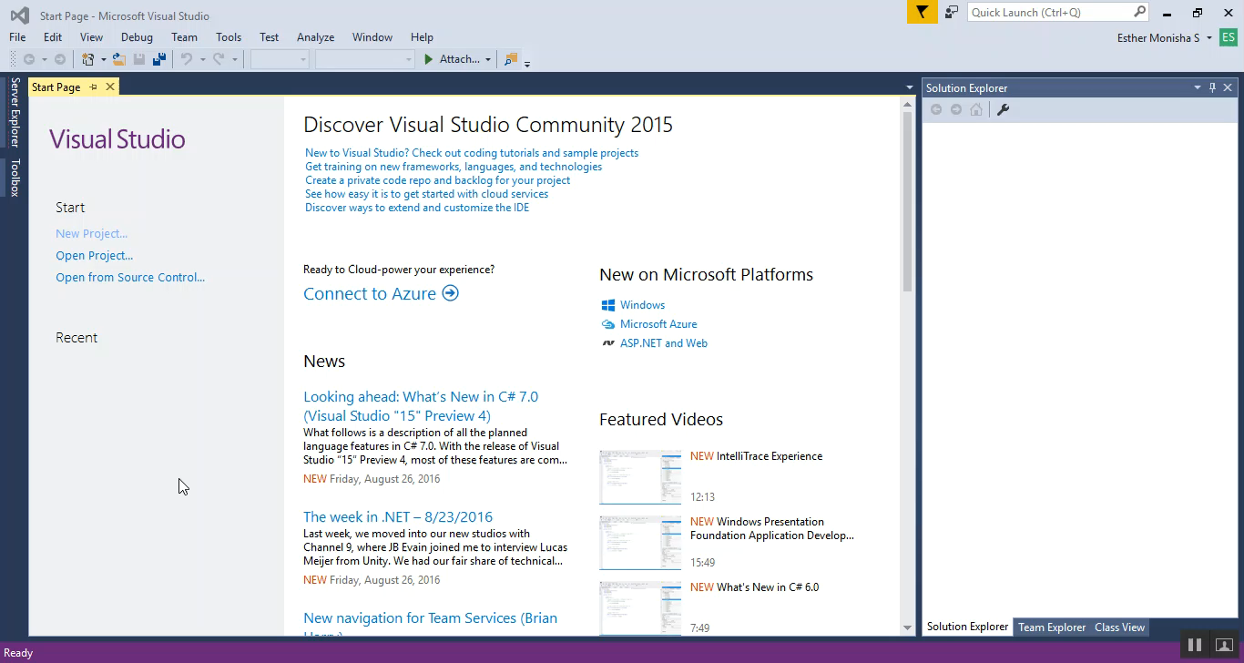
Click to play

Slide 5
APIs used
LUIS – link
Wunderground API - link

Slide 6
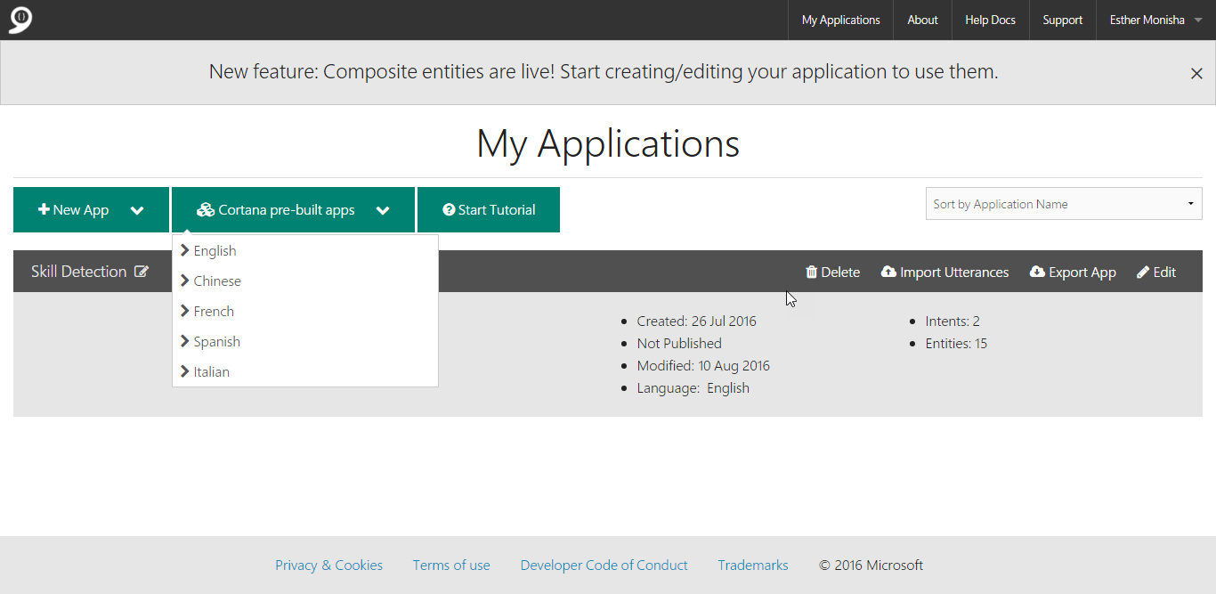
luis.ai

Slide 7
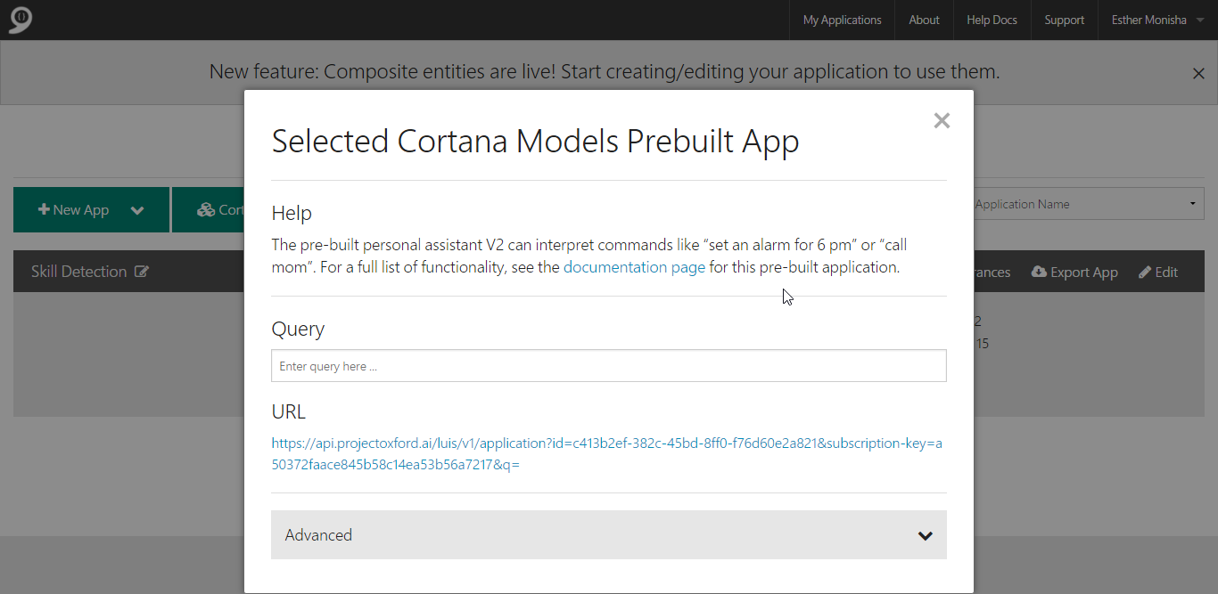
luis.ai

Slide 8
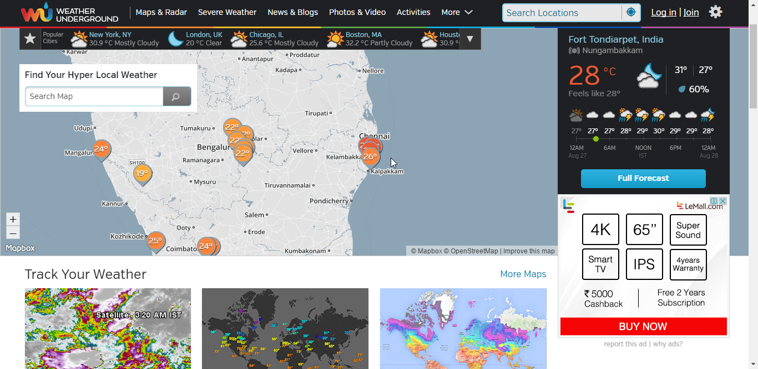
api.wunderground.com

Slide 9
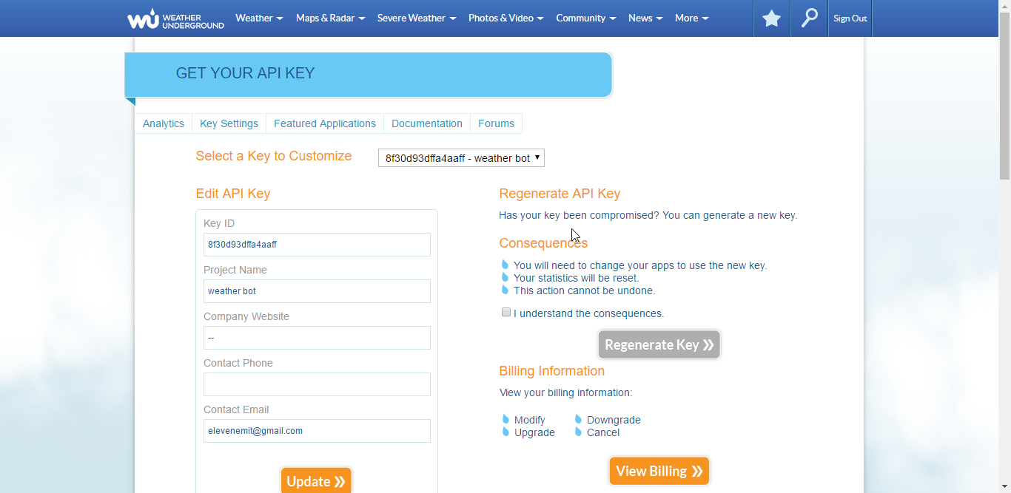
api.wunderground.com

Slide 10
private static async Task<string> QueryLuisWeatherLocation(string message)
{
using (var client = new HttpClient())
{
dynamic response = JObject.Parse(await client.GetStringAsync(@"https://api.projectoxford.ai/luis/v1/application?id=<yourID>&subscription-key=<yourKey>&q=" + System.Uri.EscapeDataString(message)));
var intent = response.intents?.First?.intent;
if (intent == "builtin.intent.weather.check_weather")
{
var entity = response.entities?.First;
if (entity?.type == "builtin.weather.absolute_location")
{ return entity.entity; }
}
return null;
}
}

Slide 11
private static async Task<string> GetCurrentWeather(string location)
{ using (var client = new HttpClient())
{ var escapedLocation = Regex.Replace(location, @"\W+", "_");
dynamic response = JObject.Parse(await client.GetStringAsync ($"http://api.wunderground.com/api/<yourAPIKey>/conditions/q/{escapedLocation}.json"));
dynamic observation = response.current_observation; dynamic results = response.response.results;
if (observation != null)
{ string displayLocation = observation.display_location?.full;
decimal tempC = observation.temp_c;
string weather = observation.weather;
return $"It is {weather} and {tempC} degrees in {displayLocation}.";
}
else if (results != null)
{ return $"There is more than one '{location}'. Can you be more specific?";
}
return null;
}}

Slide 12
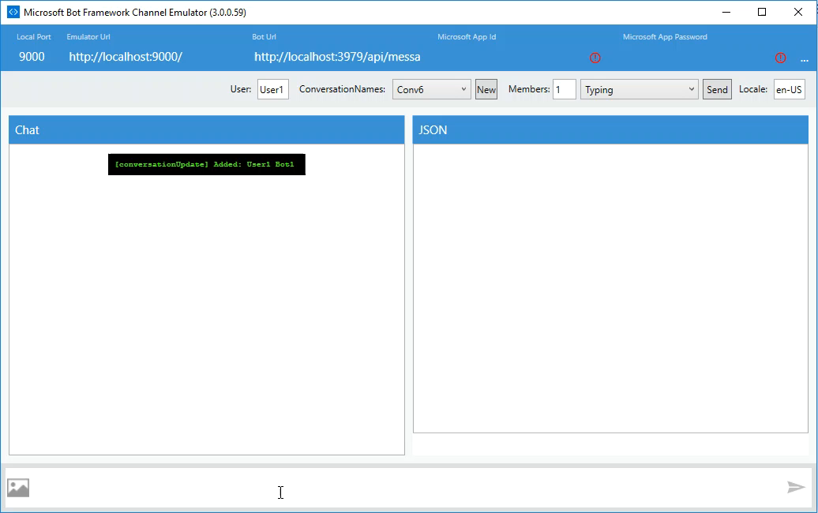
Demo
Click to play

Slide 13
Questions?
buildingchatbots@gmail.com

